Slide 1

INTERNSHIP PROJECT · VERACITIZ
Chronos AI
Watch Price Intelligence
An End-to-End Machine Learning Solution for Real-Time Price Prediction
1,488
6
71%
Watch Records Analyzed
Regression Models Evaluated
R² Score Achieved
Ready
Production-Ready Deployment
Machine Learning Internship Project · Veracitiz
https://github.com/Rudra2986/watch-price-prediction

Slide 2

01 · PROBLEM STATEMENT
The Valuation Challenge
Inconsistent Pricing
No Scalable Solution
Our Goal
Watch prices vary significantly across brand, material, movement type, and design — making manual valuation unreliable and time-consuming.
Existing approaches lack an automated, data-driven method to estimate prices at scale for e-commerce platforms.
Build an ML model that accurately predicts watch prices using historical data — from raw input to real-time price output.
Problem
AI Model
Predicted Price
This end-to-end pipeline transforms raw watch attributes into reliable price predictions, eliminating manual effort and inconsistency.

Slide 3
02 · PROJECT PIPELINE
Project Workflow
01
02
Raw Data
Data Cleaning
Collect the source watch records and attributes.
Remove errors, duplicates, and missing values.
03
04
EDA
Feature Engineering
Explore trends, patterns, and key relationships.
Transform raw inputs into model-ready signals.
05
06
Model Training
Evaluation
Train predictive models on prepared data.
Measure accuracy and compare model performance.
07
08
Hyperparameter Tuning
Deployment
Optimize settings to improve prediction quality.
Launch the final model for real-time use.
A streamlined end-to-end workflow that summarizes the full project from raw data to deployment, giving a fast, professional overview at a glance.

Slide 4
02 · TECHNOLOGY
Technology Stack
Display the complete technology stack used in the project with modern icons and clean visual cards:
Python
Pandas
NumPy
Programming Language
Data Manipulation
Numerical Computing
Scikit-Learn
CatBoost
Optuna
ML Preprocessing
Gradient Boosting
Hyperparameter Tuning
SHAP
Streamlit
GitHub
Explainability
Web Deployment
Version Control
A modern, production-grade tech stack combining data science, machine learning, and web deployment tools.

Slide 5
03· DATASET
Dataset Overview
The WatchVine E-Commerce Dataset was scraped and cleaned to support production-grade watch price modeling.
3000+
1,488
Raw Columns
Records
Initially scraped, later reduced
Final cleaned dataset
25+
15
Features
Brands
Meaningful input variables
Distinct watch brands represented
Main feature categories
1
2
Brand
Material
Brand identity and positioning
Case and strap materials
3
4
Watch Type
Category
Analog, digital, or hybrid formats
Product classification
5
6
Dial Color
Strap Color
Visual style of the watch face
Primary strap appearance
7
8
Movement Type
Case Diameter
Quartz, automatic, or other mechanisms
Size dimension in millimeters
9
10
Water Resistance
Is Automatic
Durability and usage rating
Binary indicator for automatic movement
The dataset combines brand, design, and technical specifications to create a strong feature set for pricing analysis and predictive modeling.

Slide 6
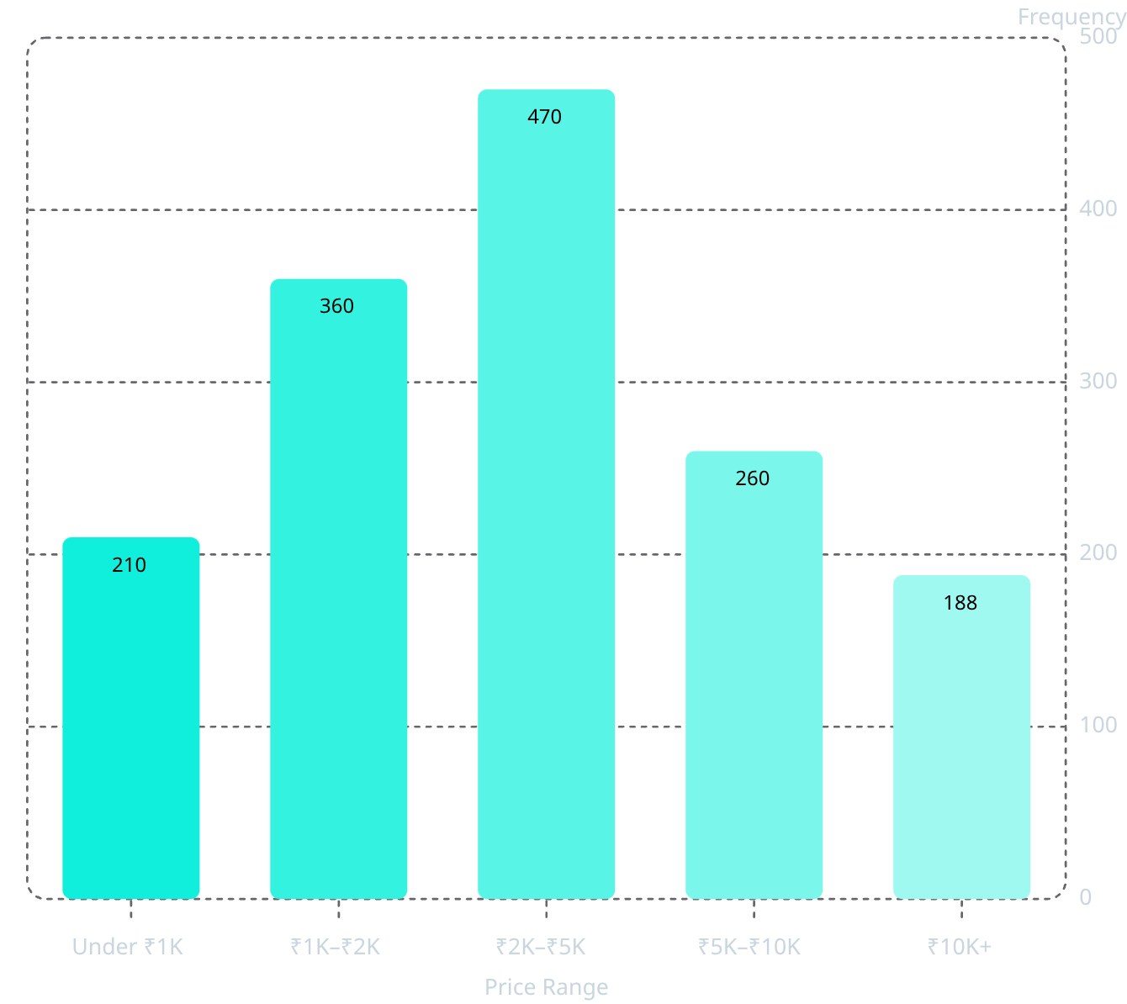
04 · DATA PREPARATION
Data Cleaning & Exploratory Data Analysis
Cleaning Pipeline
Price Distribution
Removed 3000+ irrelevant scraped columns
Converted price strings to numeric INR values
Handled missing values & standardized text fields
Removed leakage-prone columns
These steps produced a cleaner, model-ready feature set with consistent formatting and reduced noise.
The distribution is concentrated in the mid-range, with fewer watches at the premium end, indicating a right-skewed pricing pattern.

Slide 7
05 · FEATURE ENGINEERING
Feature Engineering
Feature engineering transformed raw watch data into structured inputs that improved model performance and made patterns easier for the model to learn.
Binary Features
Categorical Encoding
Is Automatic and Is Luxury Brand capture key yes/no signals that are easy for the model to interpret.
Brand, Material, and Watch Type were encoded to convert text categories into usable numeric features.
Numerical Scaling
Feature Selection
Case Diameter and Water Resistance were scaled to keep numeric features on comparable ranges.
Redundant and leakage-prone columns were removed to keep only the most informative variables for training.
Encoding Strategy
Impact
One-hot encoding for low-cardinality categories
Target encoding for higher-cardinality features
Ordinal handling for ordered numeric-like attributes
The final feature set was cleaner, more consistent, and more predictive — helping the model learn stronger relationships and achieve better performance.

Slide 8
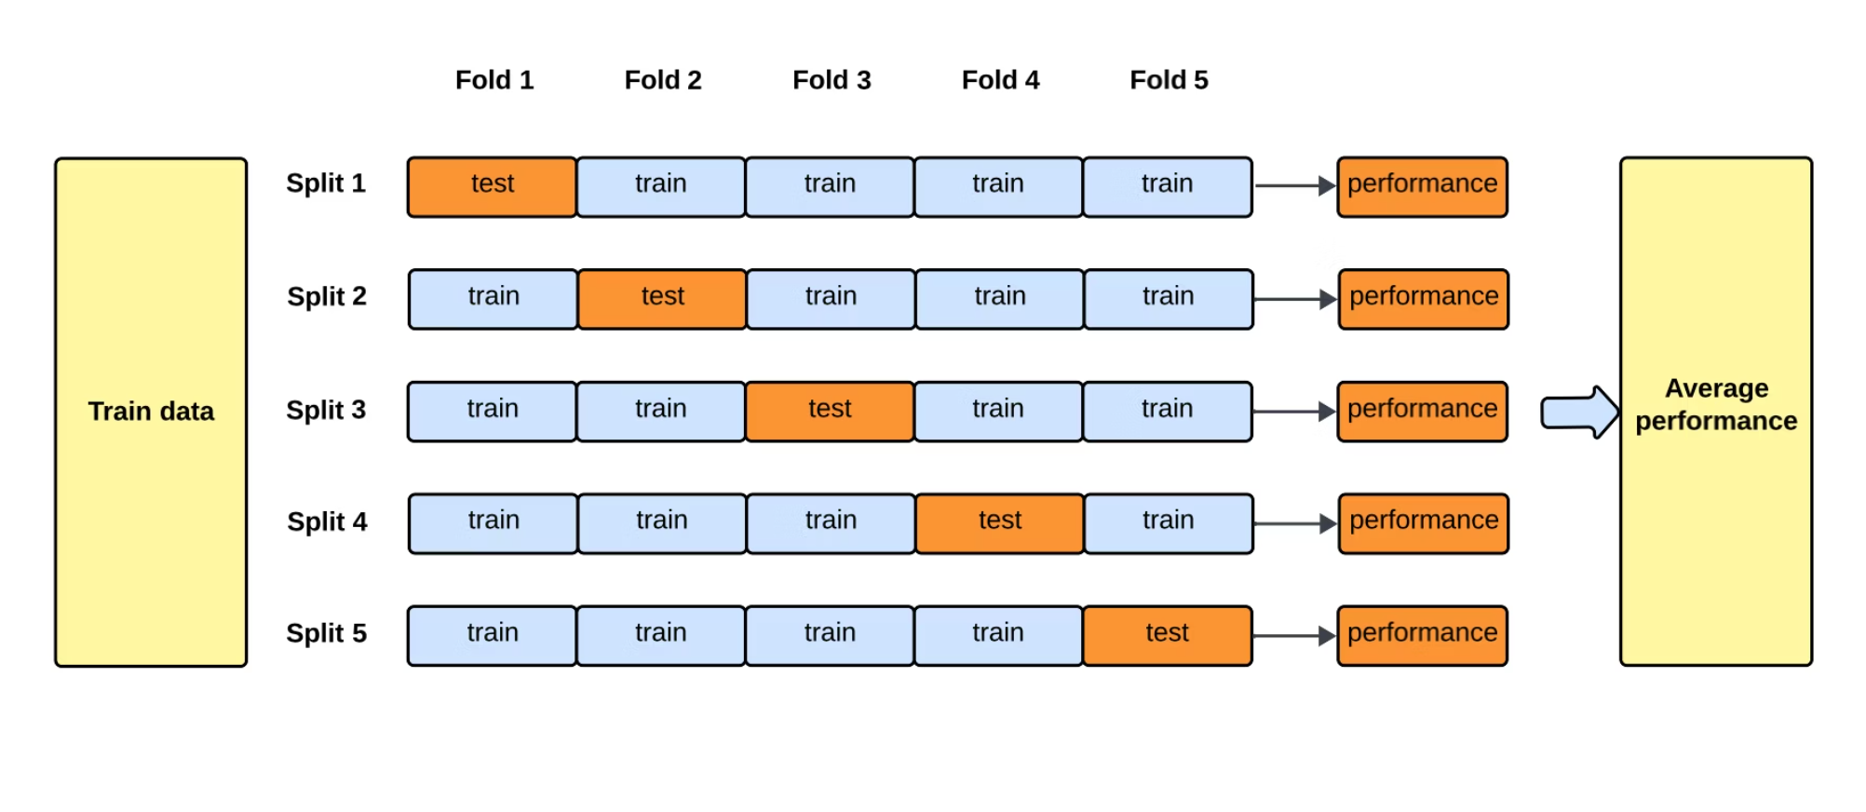
06 · MODEL DEVELOPMENT
Machine Learning Model Development
Six regression algorithms were trained and compared using 5-Fold Cross Validation to identify the best-performing model.
Linear Regression
Ridge Regression
Random Forest
XGBoost
Baseline model that fits a straight-line relationship between inputs and the target.
Regularized linear model that reduces the impact of correlated features.
Ensemble of trees that captures non-linear patterns and interactions.
Gradient boosting method that sequentially improves accuracy.
LightGBM
CatBoost
Fast boosting framework designed for efficient training on larger datasets.
Boosting model that handles categorical features with minimal preprocessing.
5-Fold Cross Validation
This process provides a more reliable estimate of real-world performance by testing each model across multiple data splits. Final performance = Average of 5 validation scores.

Slide 9
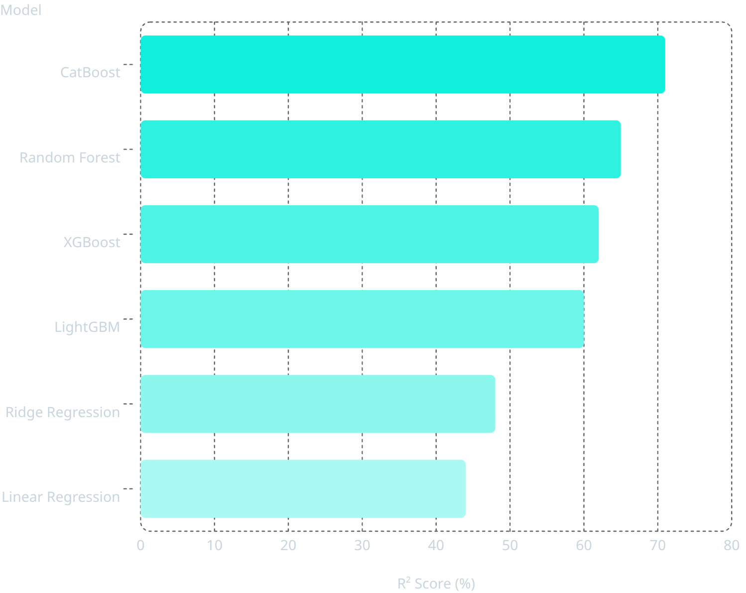

06 · EVALUATION
Model Evaluation & Selection
Why CatBoost?
Best Fit
Highest variance explained across all six models.
Categorical Strength
Native handling of categorical features with minimal preprocessing.
Consistent Validation
Strong and stable performance across 5-Fold Cross Validation.
Model Comparison Table
Model Name
R² Score
Linear Regression
45%
Ridge
49%
Selected as Final Model: Highest R² score (71%) with superior handling of categorical features and consistent cross-validation performance.
Random Forest
65%
XGBoost
62%
LightGBM
60%
CatBoost (Winner)
71%

Slide 10
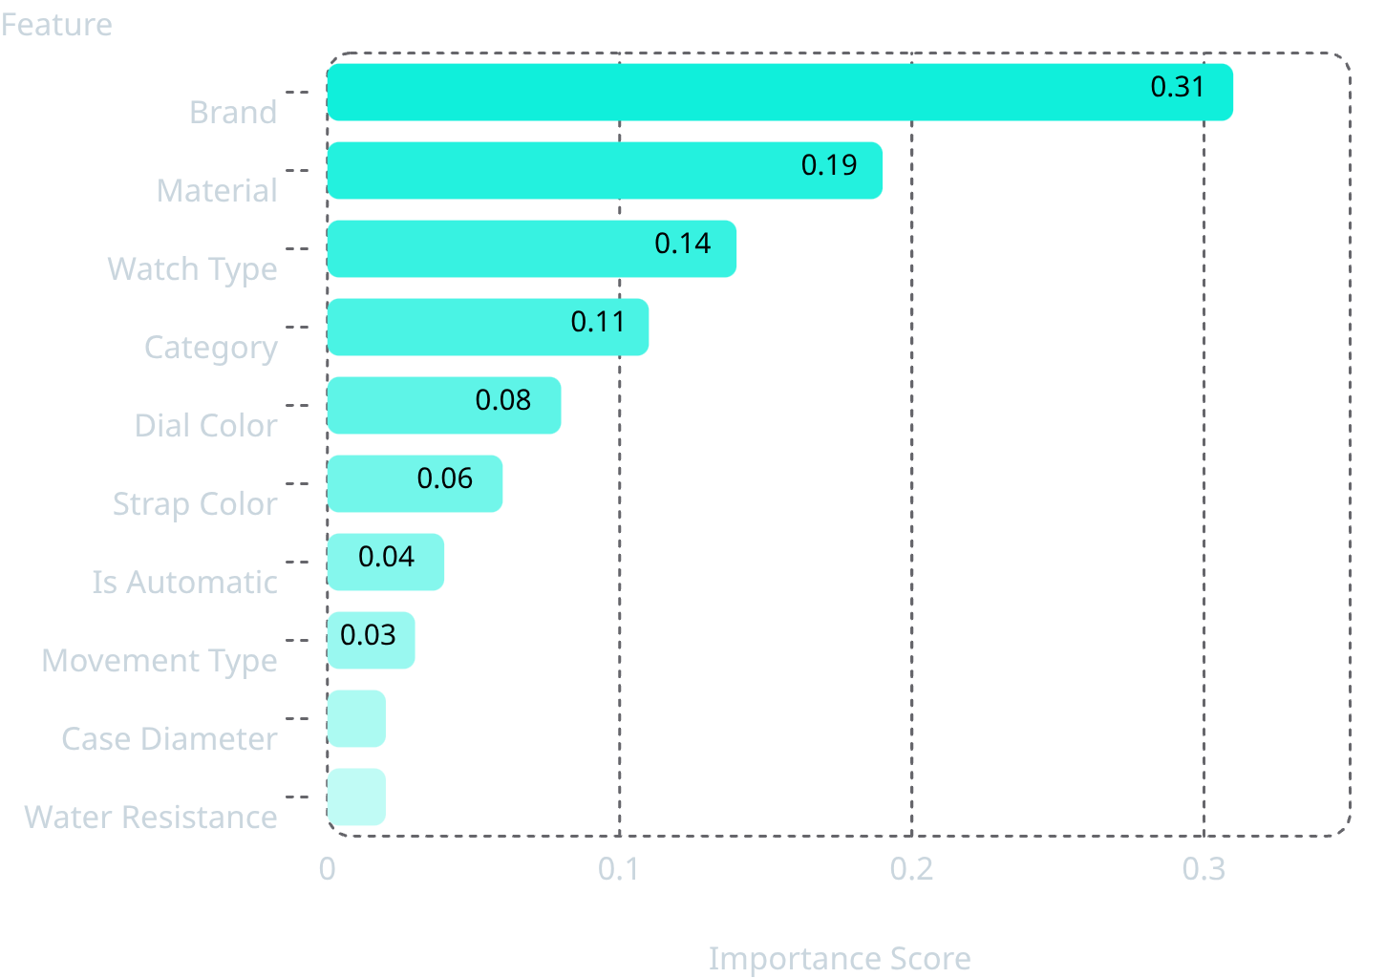
07 · OPTIMIZATION
Hyperparameter Tuning & Explainable AI
SHAP Explainability
SHAP values reveal which features most influence price predictions, enabling model interpretability and trust.
Optuna — 100 Trials
Automated Bayesian optimization to find the best CatBoost setup.
Iterations
Depth
540
5
Learning Rate
0.0465

Slide 11

08 · DEPLOYMENT
Deployment Architecture
User Input
Feature Processing
CatBoost Model
Price Prediction
From user input to price output in seconds — the Chronos AI pipeline delivers production-ready predictions through a clean, intuitive interface.
Architecture Overview
User Input
Feature Processing
CatBoost Model
Price Prediction
Watch attributes collected via interactive form
Raw inputs transformed into model-ready features
Trained regression model making predictions
Real-time output with confidence scores

Slide 12
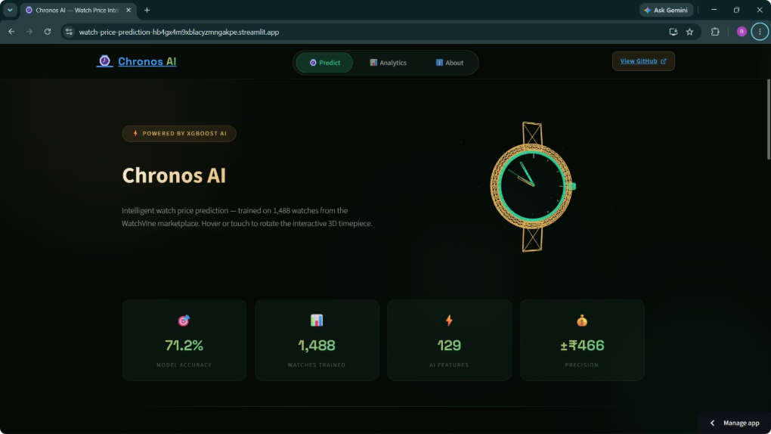
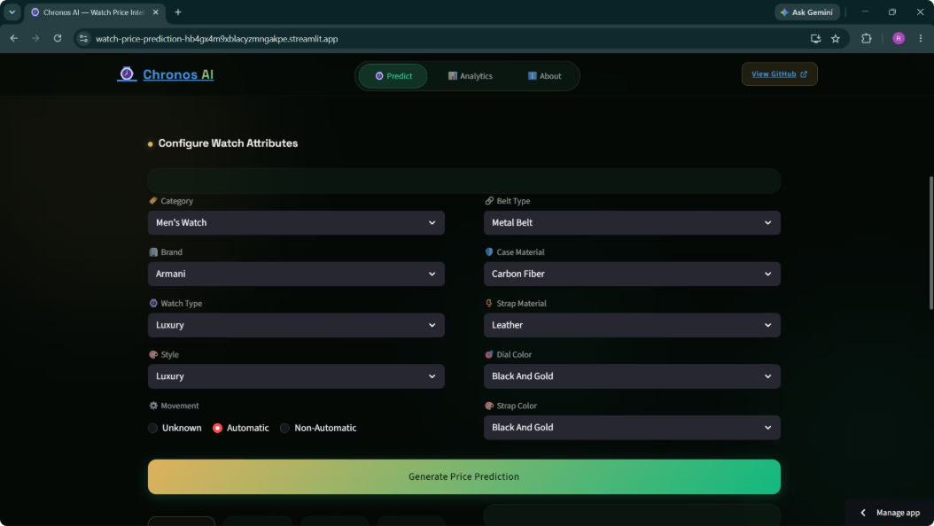
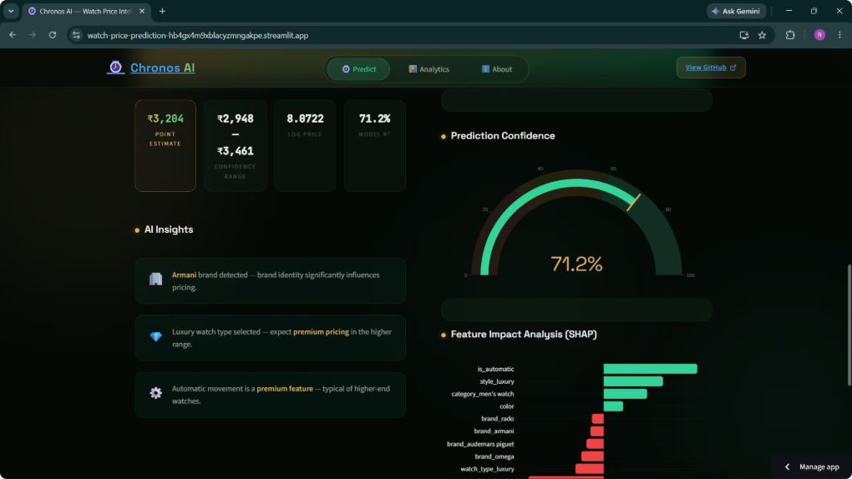
09 · LIVE APPLICATION
Chronos AI — Live Application
Home Page
Prediction Page
Results Page
App overview and navigation
Enter watch attributes
Price output and explanations
Chronos AI is deployed as a production-ready Streamlit web application, enabling real-time watch price predictions with explainable AI insights.

Slide 13
10 · RESULTS & ROADMAP
Results, Challenges & Future Scope
71%
₹466
₹294
R² Score
RMSE
MAE
Final CatBoost model performance
Root Mean Squared Error
Mean Absolute Error
0.07%
Brand Unknown
Down from 87.5% — critical fix
Business Impact
Automated watch valuation
Reduced manual price estimation effort
Scalable for e-commerce platforms
Real-time prediction capability
Production-ready deployment
🏆 Challenge Solved
🔭 Future Scope
Brand Sparsity Problem:
Larger, more diverse datasets
Image-based watch analysis (CNN/ViT)
Text embeddings from product descriptions
Automated retraining pipeline
Cloud deployment (AWS / GCP)
87.5% → 0.07%
Unknown brands reduced through intelligent feature engineering, driving significant model performance gains.
Successfully built an end-to-end Machine Learning solution — from raw scraped data to production-ready deployment. Chronos AI is live.

Slide 14
11 · KEY LEARNINGS
Key Learnings & Achievements
This project provided comprehensive experience across the machine learning lifecycle, highlighting mastery in:
End-to-End Machine Learning Pipeline
Data Cleaning & EDA
Feature Engineering
Regression Modeling
Achievement Badges
End-to-End ML Pipeline
Explainable AI
Hyperparameter Optimization
Production Deployment
This project demonstrates mastery of the complete machine learning lifecycle, from data acquisition to production deployment.
Thank You
Questions & Discussion Welcome
Rudra Patel · Machine Learning Intern · Veracitiz

Slide 15


12 · PROJECT LINKS
Project Links & Resources
GitHub Repository
Live Application
Complete source code, notebooks, and documentation
GitHub - Rudra2986/watch-price-prediction: Watch price prediction model using ML
Try Chronos AI in action
Chronos AI — Watch Price Intelligence
GitHub Repository QR Code
Live Application QR Code
Scan to access the project or visit the links above

